Slide 1

Introduction to Maven

Slide 2
Agenda
Apache Maven
Objectives
Repository
How to Maven
Project Object Model
Command Line
Maven Central

Slide 3
Maven
What is Apache Maven?
Apache Maven is a software management and comprehension tool for java development

Slide 4
Maven
Objectives
Dependency Management
Compile Source Code
Run Unit Test
Build Project
Deploy Code

Slide 5
Maven
Repository
Central Repository
maven repository or internet repository
Remote Repository
organization repository
Local Repository
client repository (cache into .m2 folder under user home directory)
Notes:
How to change .m2 go to maven_home/conf/settings.xml
ex. <localRepository>/path/to/local/repo</localRepository>

Slide 6
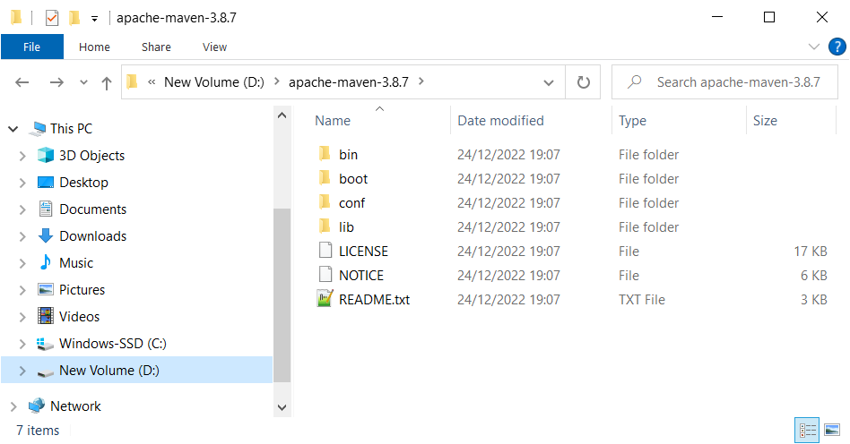
Maven
How To Maven
Go to https://maven.apache.org
Download & Install
ex. apache-maven-3.8.7-bin.zip

Slide 7
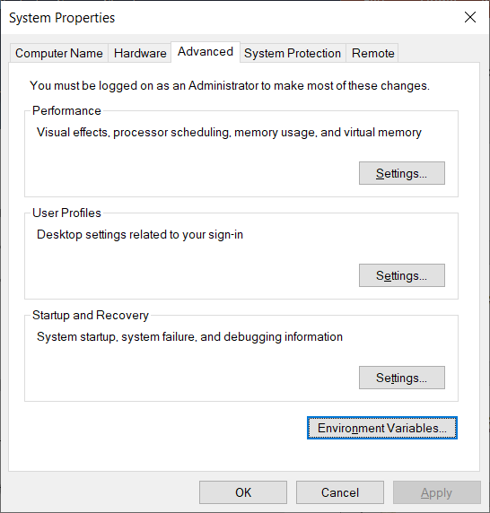
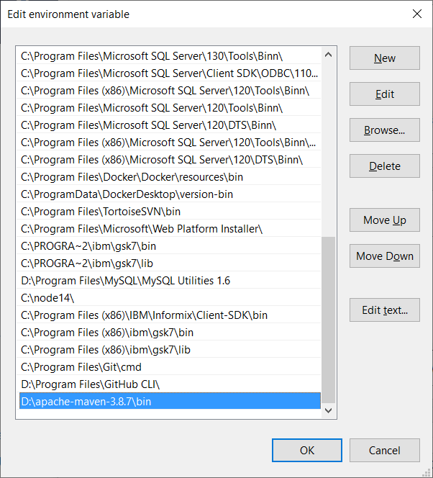
Maven
How To Maven
Setting Environment
Settings -> System -> About -> Advanced System Setting -> Advanced -> Environment Variables

Slide 8
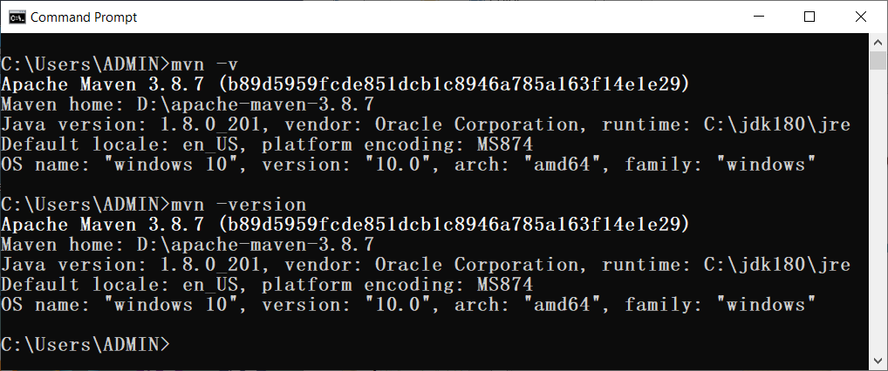
Maven
How To Maven
Examine
mvn -v or mvn --version

Slide 9
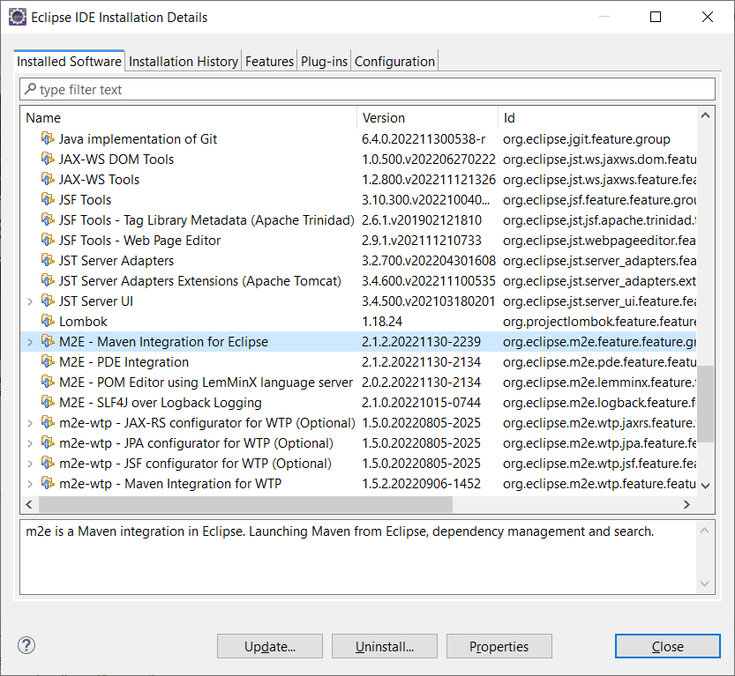
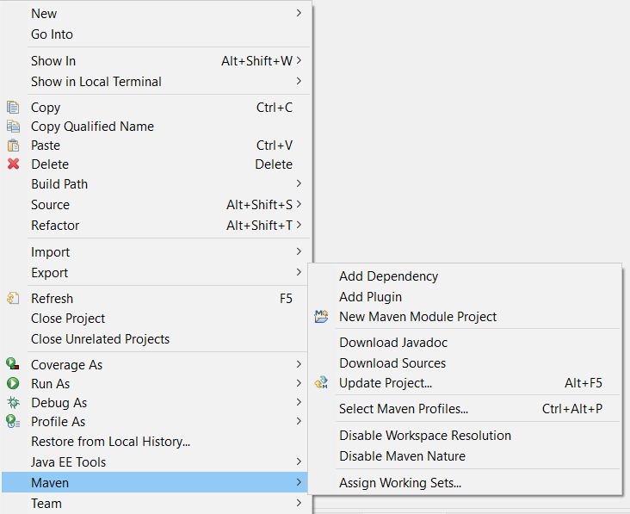
Maven
How To Maven
IDE Plugin

Slide 10
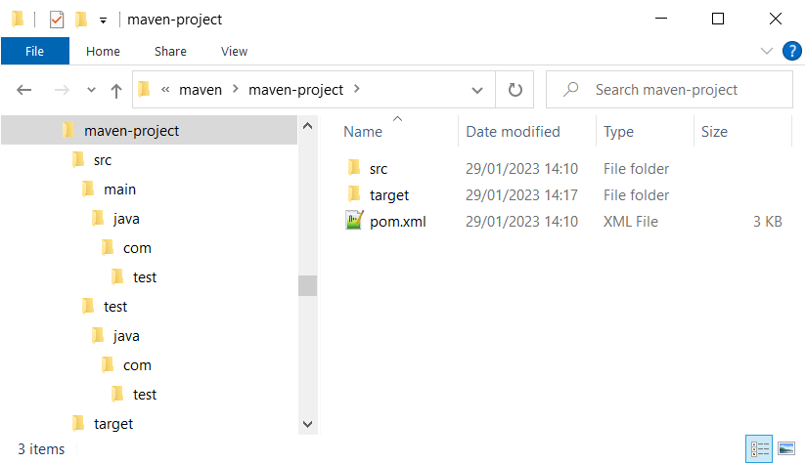
Maven
Project Structure
src folder – keep java file
target folder – keep class file
pom.xml – configuration file

Slide 11
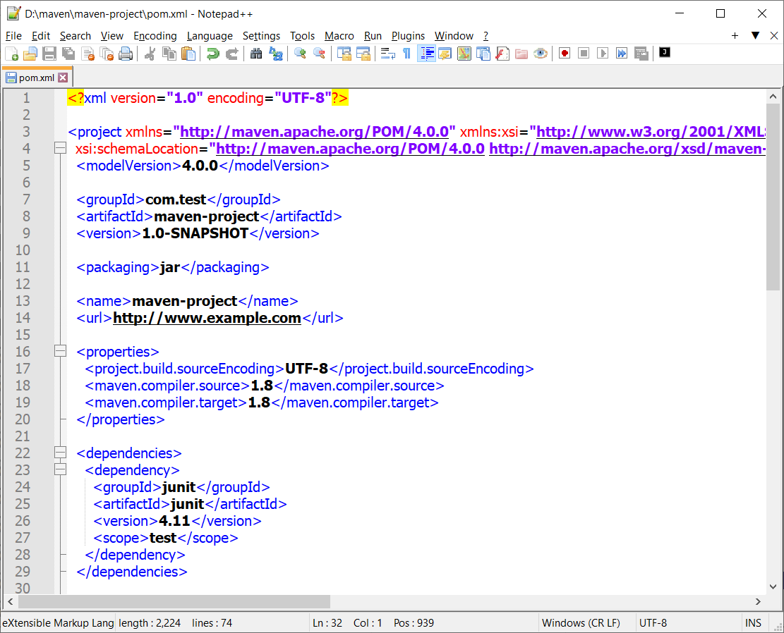
Maven
Project Object Model
pom.xml configuration file - I
Project Information
Output Result
Properties
Dependencies

Slide 12
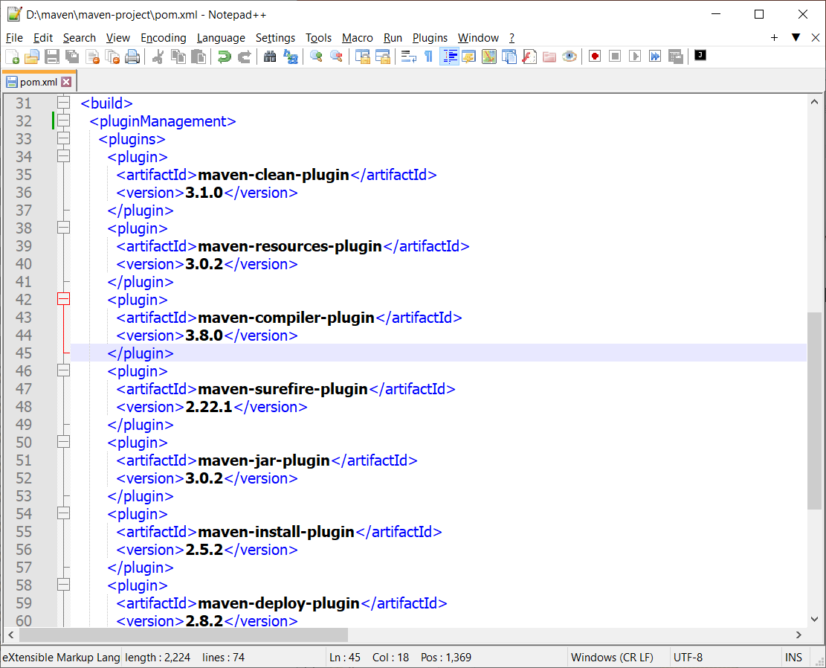
Maven
Project Object Model
pom.xml configuration file - II
Build Plugins

Slide 13
Maven
Project Object Model
Project Information
groupId – name space or project package
artifactId – unique application name
version – current version of artifact
Output Result – jar/war/ear
Properties – project configurations
Dependencies – project libraries
Build
plugins – requirement plugins

Slide 14
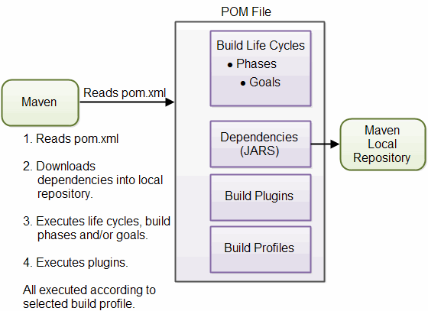
Maven
Project Object Model
Life Cycle
Notes:
Build life cycle
Validate 2. Compile 3. Test 4. Package 5. Install 6. Deploy

Slide 15
Maven
Command Line
Command | Description
mvn achetype:generate | Create new maven project
mvn compile | Compile java source code files
mvn test | Run test classes
mvn clean | Delete all class files
mvn package | Build jar/war file
mvn install | Build jar file and register to local repository (.m2 folder)
mvn exec:java | Run main class

Slide 16
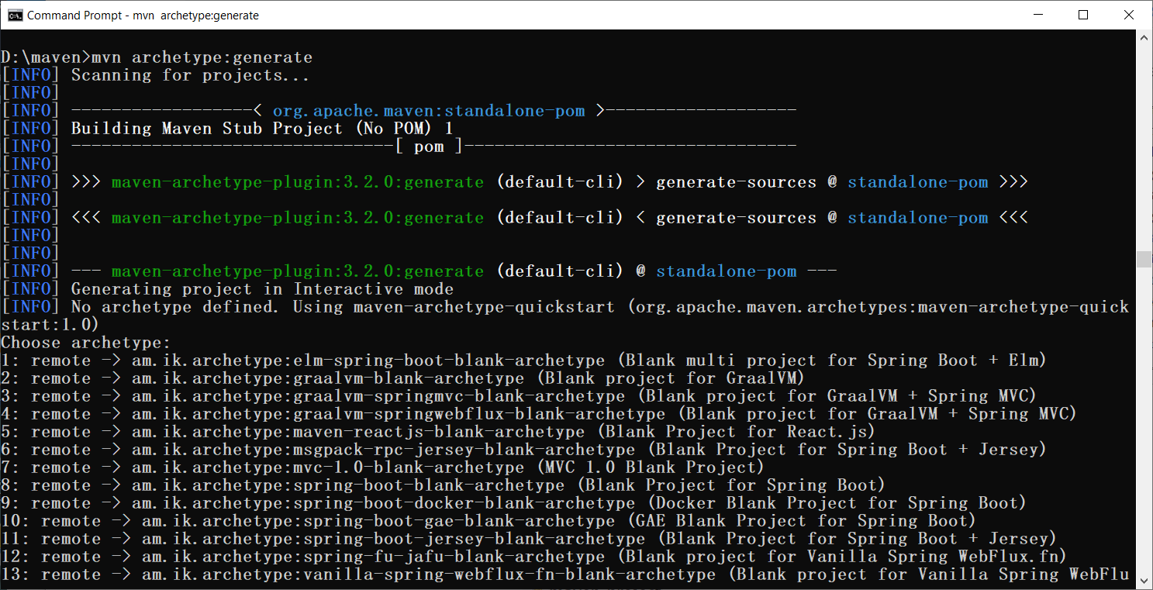
Maven
Command Line
mvn archetype:generate
jar package
Notes:
2005 - org.apache.maven.archetypes:maven-archetype-quickstart (jar)
2010 - org.apache.maven.archetypes:maven-archetype-webapp (war)

Slide 17
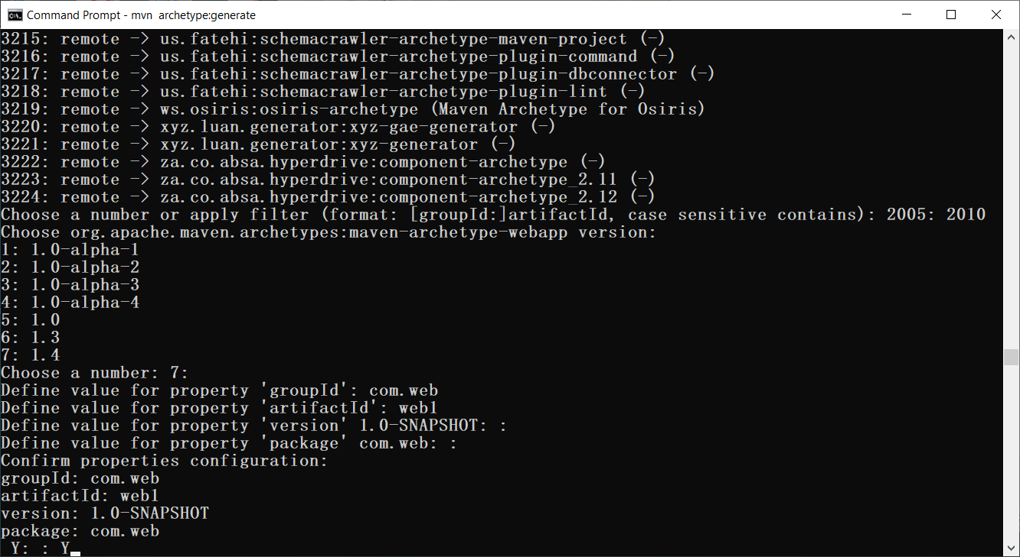
Maven
Command Line
mvn archetype:generate
war package
Notes:
2005 - org.apache.maven.archetypes:maven-archetype-quickstart (jar)
2010 - org.apache.maven.archetypes:maven-archetype-webapp (war)

Slide 18
Maven
Command Line
mvn archetype:generate
jar package
war package
mvn archetype:generate -DarchetypeGroupId=org.apache.maven.archetypes \
-DarchetypeArtifactId=maven-archetype-quickstart -DarchetypeVersion=1.4
mvn archetype:generate -DarchetypeGroupId=org.apache.maven.archetypes \
-DarchetypeArtifactId=maven-archetype-webapp -DarchetypeVersion=1.4

Slide 19
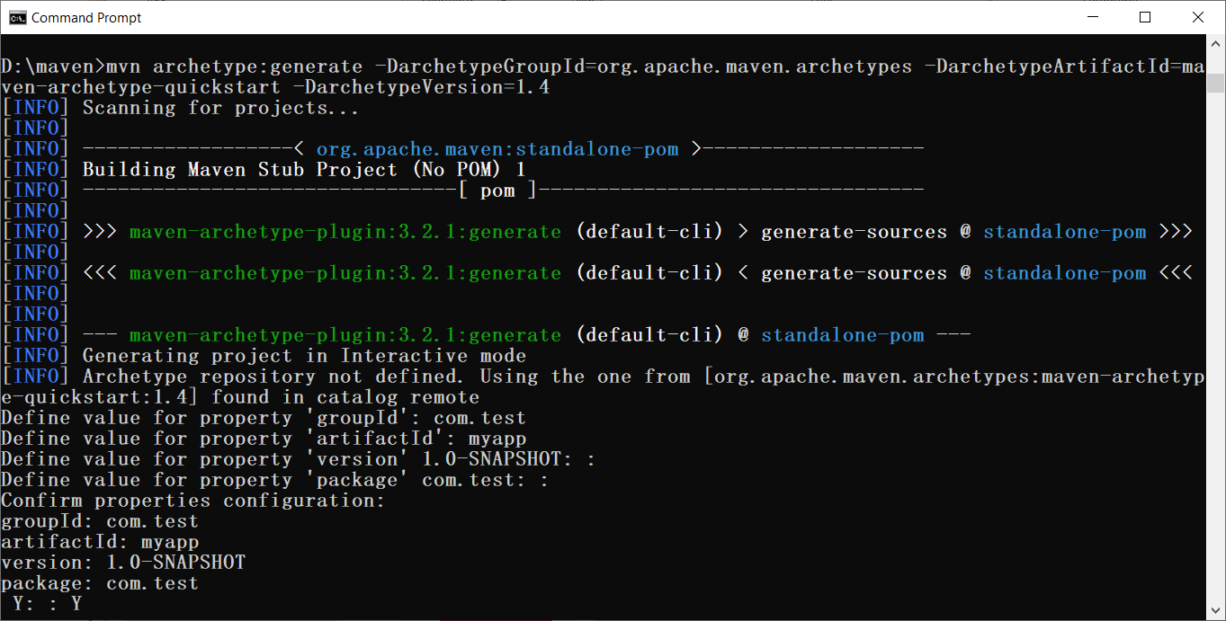
Maven
Command Line
mvn archetype:generate
jar package

Slide 20
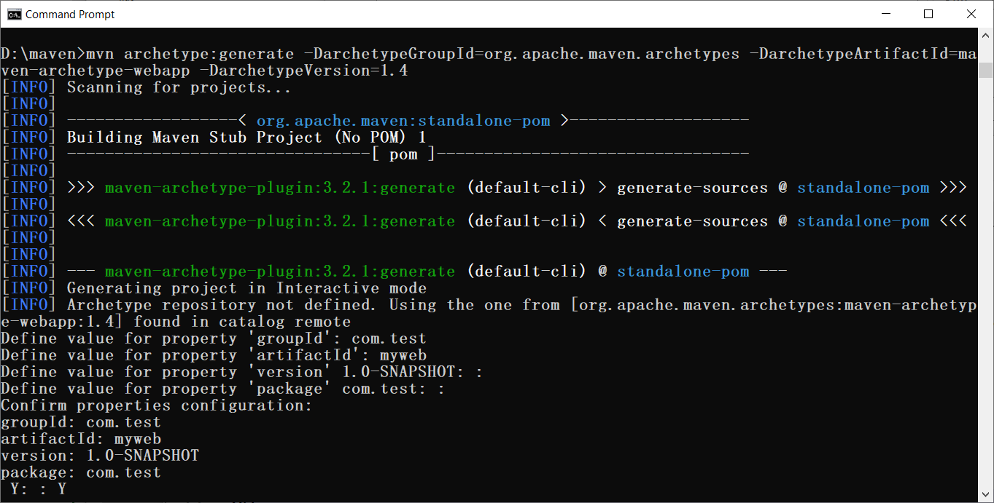
Maven
Command Line
mvn archetype:generate
war package

Slide 21
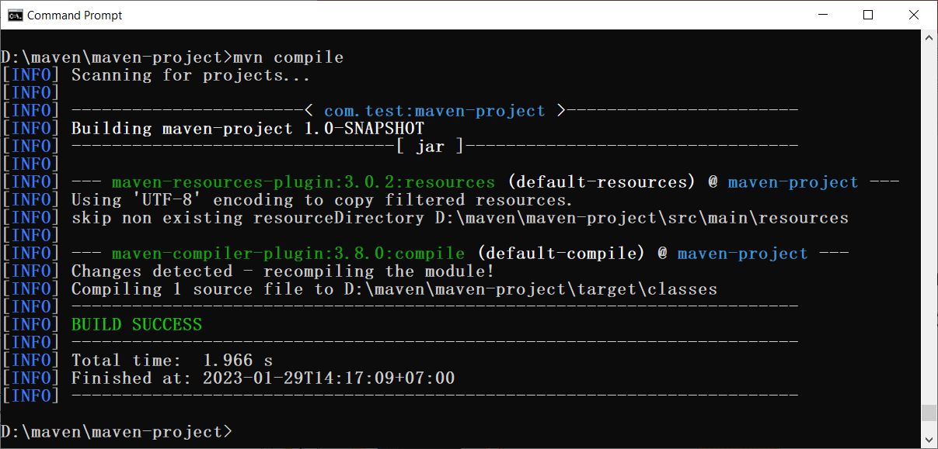
Maven
Command Line
mvn compile

Slide 22
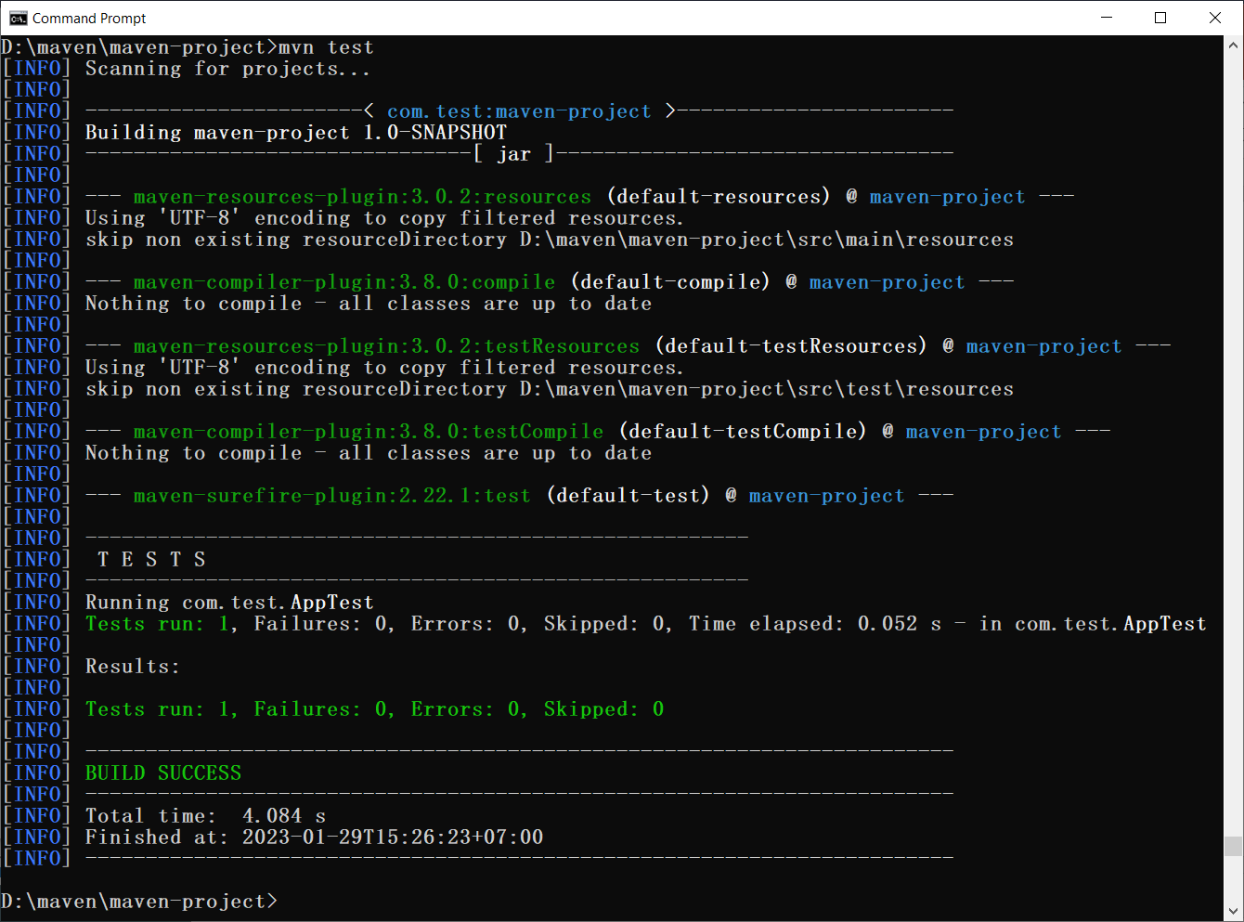
Maven
Command Line
mvn test

Slide 23
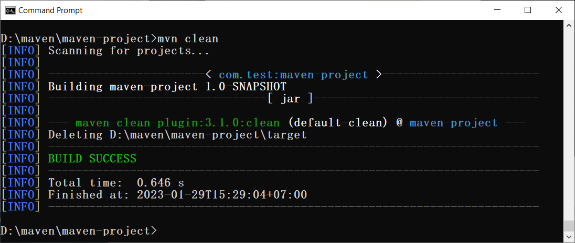
Maven
Command Line
mvn clean

Slide 24
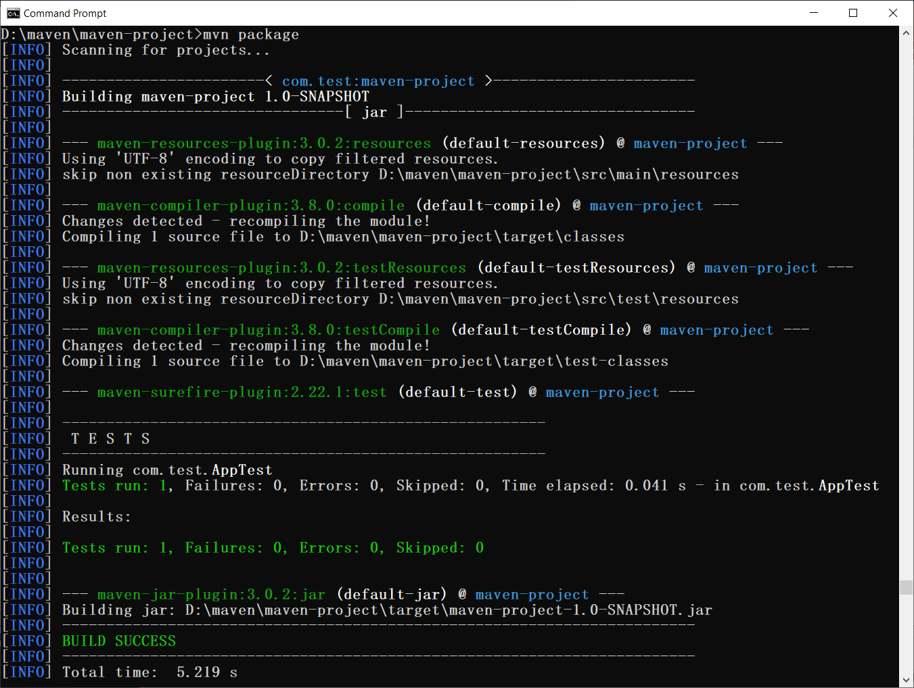
Maven
Command Line
mvn package

Slide 25
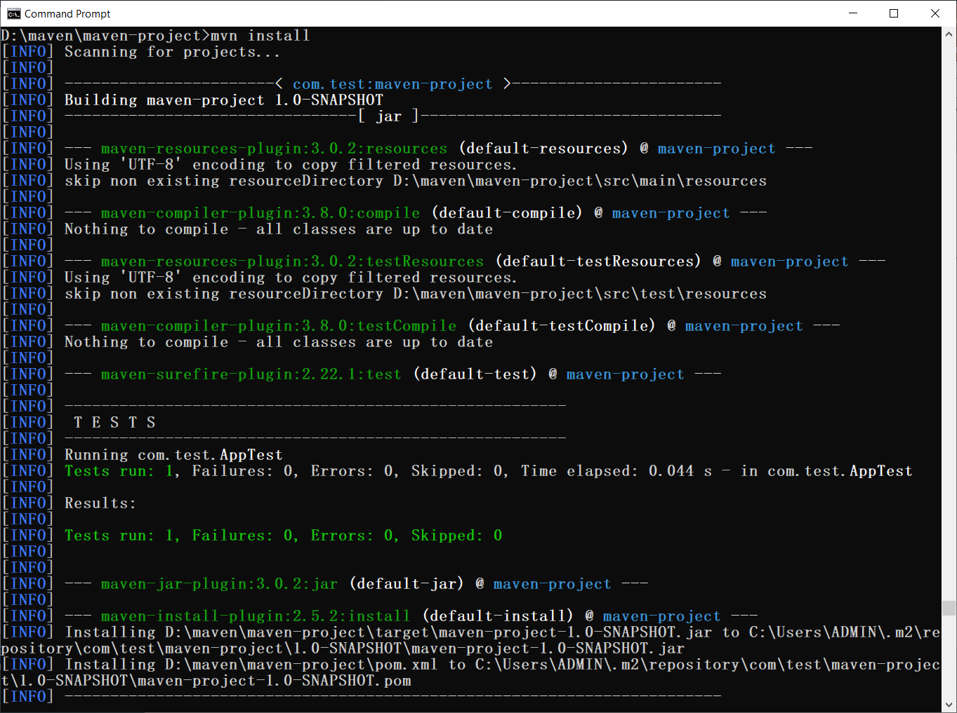
Maven
Command Line
mvn install

Slide 26
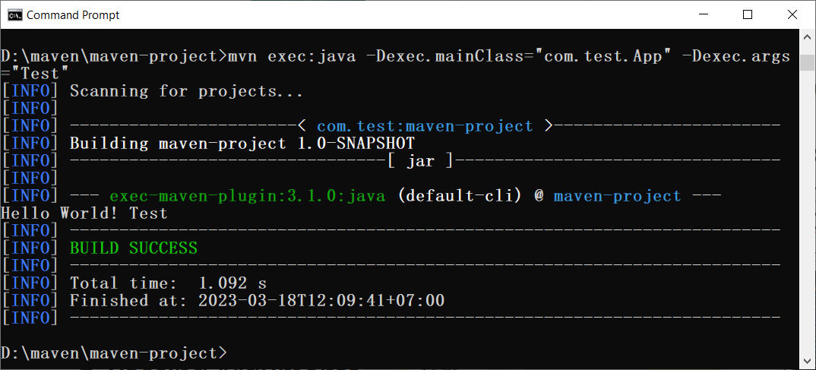
Maven
Command Line
mvn exec:java -Dexec.mainClass="main.Class" -Dexec.args="pr1 pr2 pr3 prN"

Slide 27
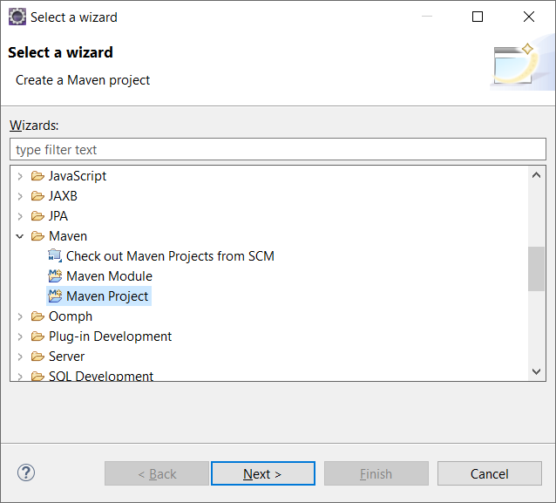
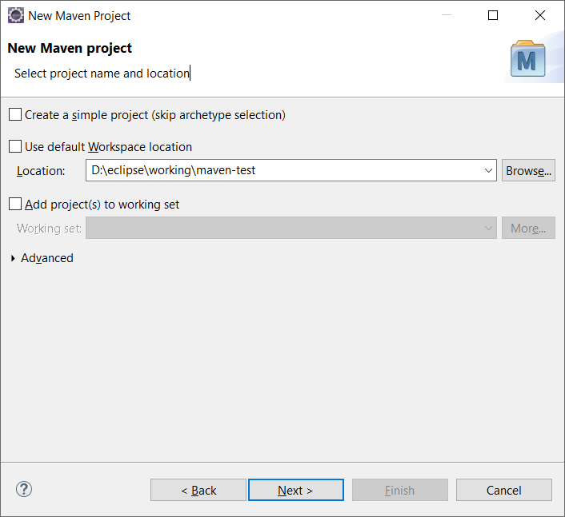
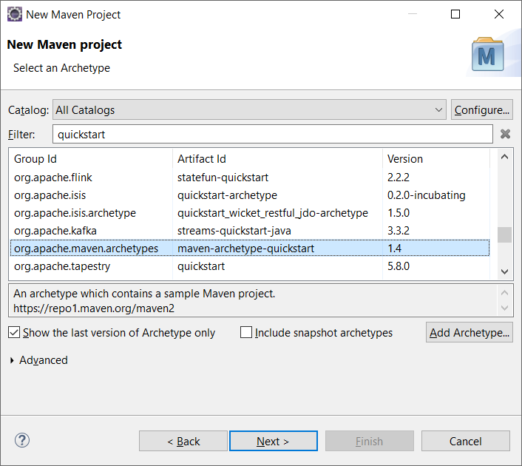
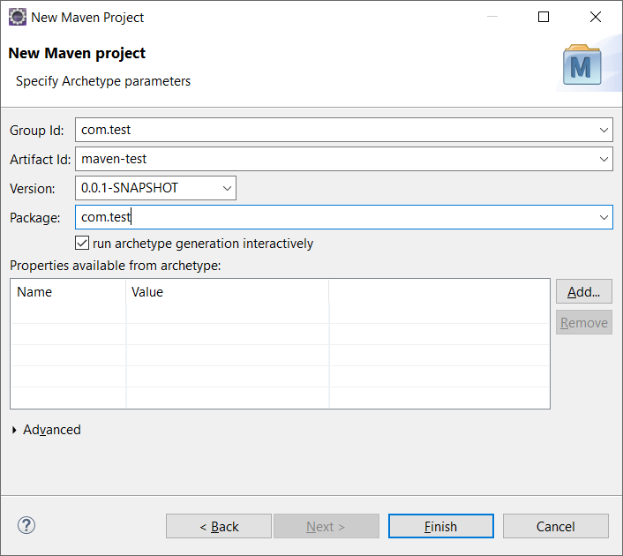
Maven
Eclipse IDE Plugin
File -> New -> Other (jar)
1
2
3
4

Slide 28
Maven
Eclipse IDE Plugin
File -> New -> Other (jar)
3

Slide 29
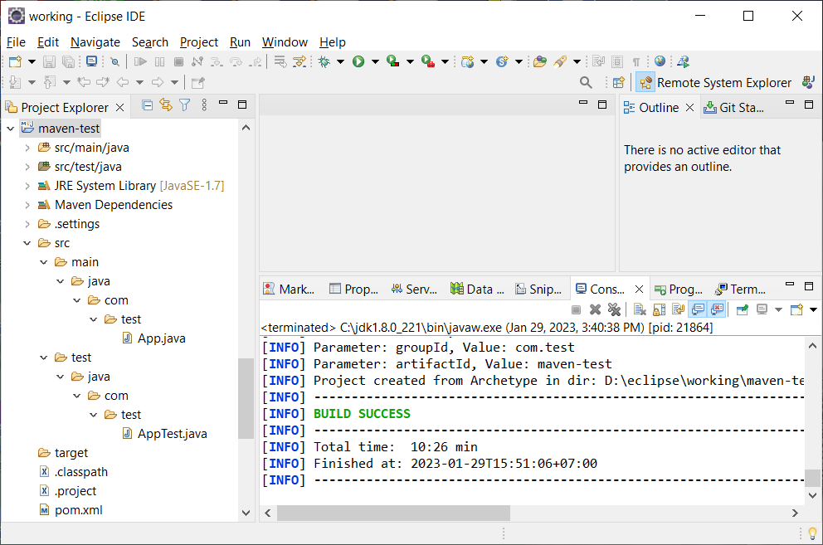
Maven
Eclipse IDE Plugin
java project

Slide 30
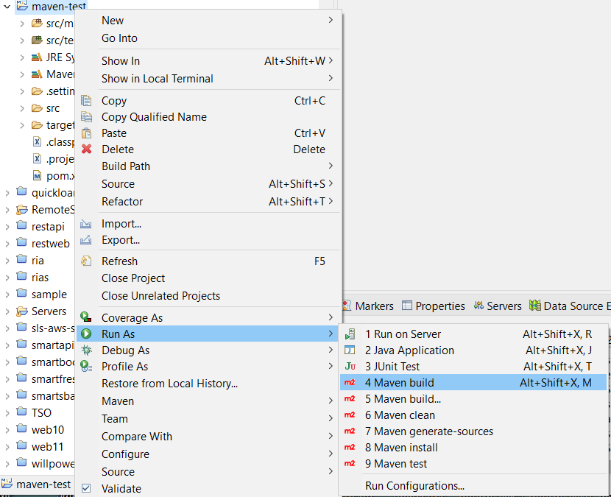
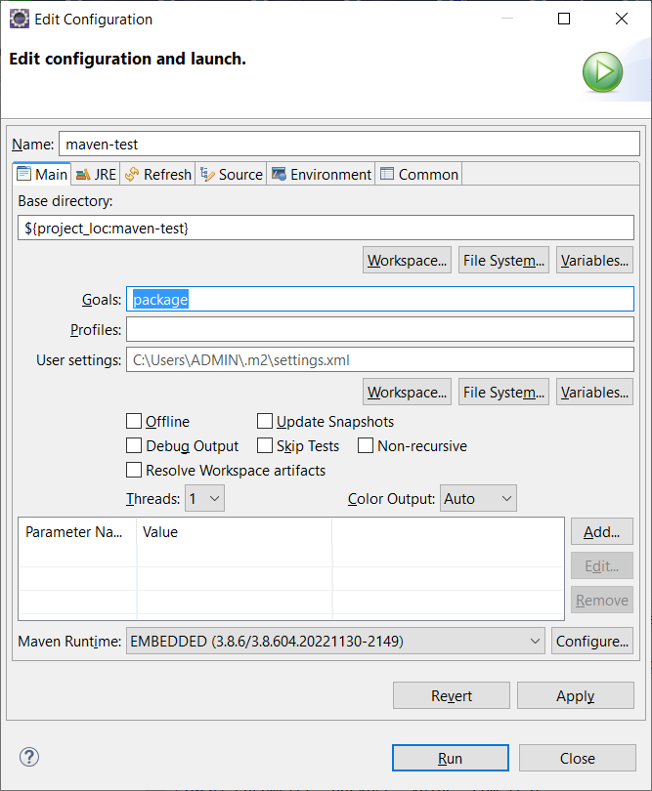
Maven
Eclipse IDE Plugin
build

Slide 31
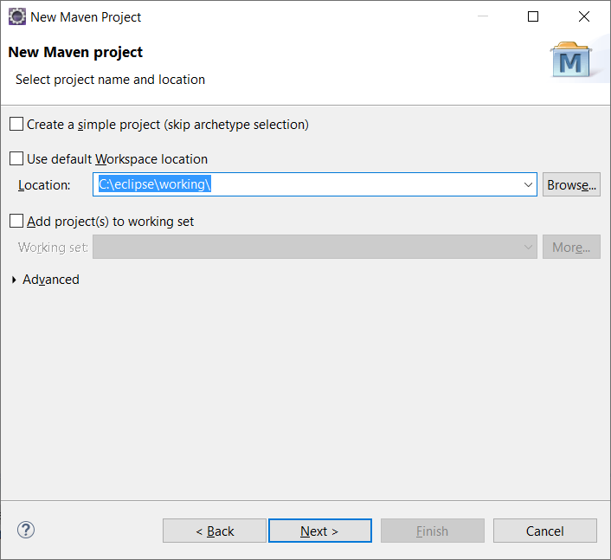
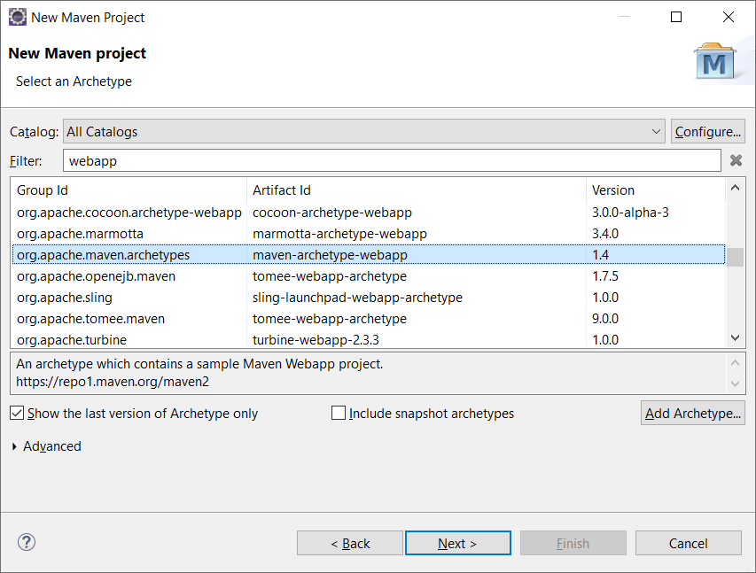
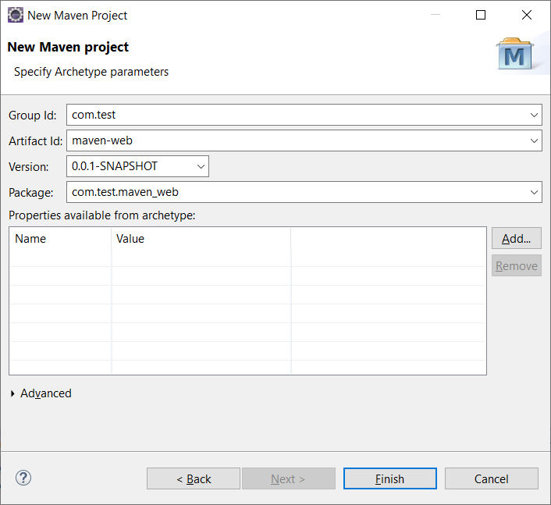
Maven
Eclipse IDE Plugin
File -> New -> Other (war)
1
2
3
4

Slide 32
Maven
Eclipse IDE Plugin
File -> New -> Other (war)
3

Slide 33
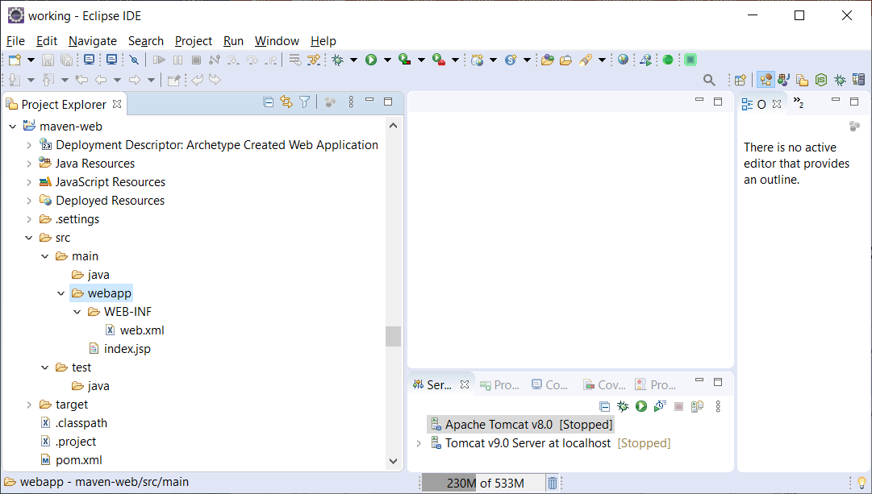
Maven
Eclipse IDE Plugin
web project

Slide 34
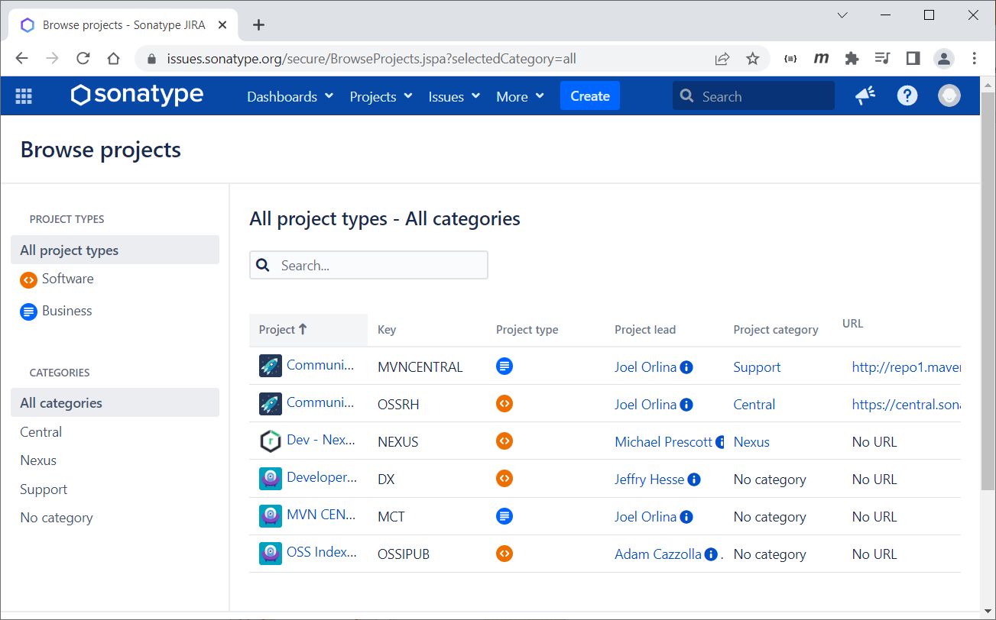
Maven
Maven Central
Go to https://issues.sonatype.org try to register

Slide 35
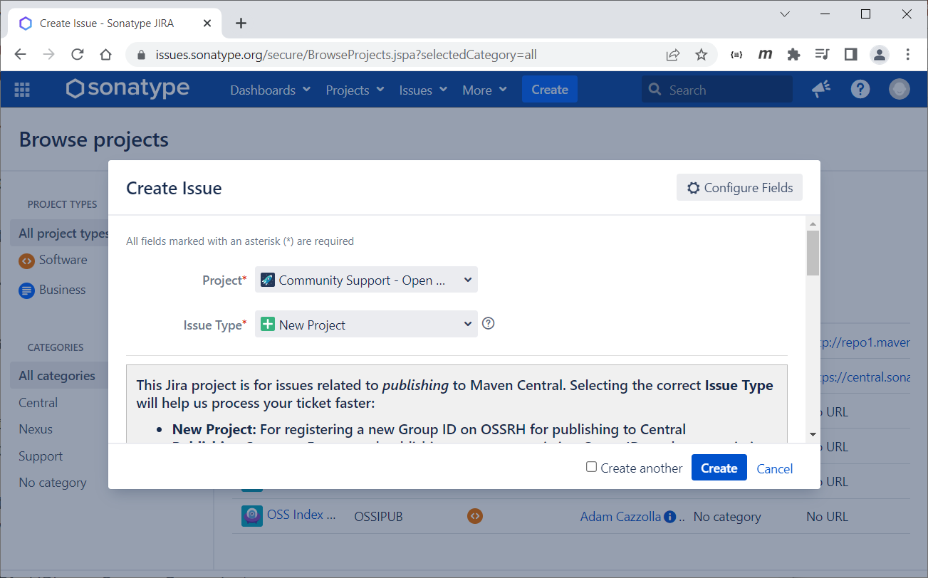
Maven
Maven Central
Create issue to request

Slide 36
Maven
Maven Central
Create issue to request
Project: Community Support - Open Source Project Repository Hosting
Issue Type: New Project
Summary: Description of your library
Group Id: Your GROUP_ID
Project URL: URL of your library
SCM URL: URL of your Source Control

Slide 37
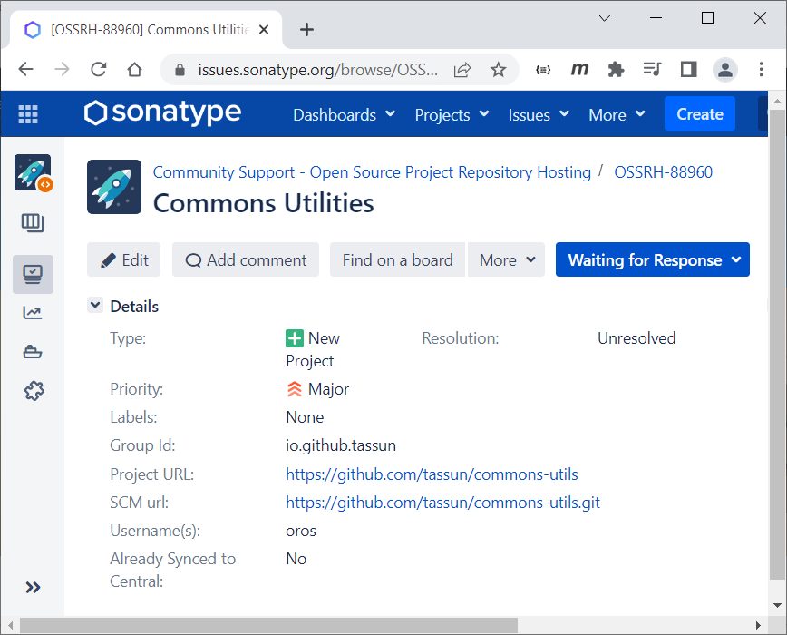
Maven
Maven Central
Create issue to request

Slide 38
Maven
Maven Central
Create issue to request
About Group ID
Service | Example groupId
GitHub | io.github.myusername
GitLab | io.gitlab.myusername
Gitee | io.gitee.myusername
Bitbucket | io.bitbucket.myusername
SourceForge | io.sourceforge.myusername

Slide 39
Maven
Maven Central
Edit pom.xml - license, developer and SCM
<licenses>
<license>
<name>The Apache License, Version 2.0</name>
<url>http://www.apache.org/licenses/LICENSE-2.0.txt</url>
</license>
</licenses>
<developers>
<developer>
<id>tassun</id>
<name>Tassun Oros</name>
<email>tassun_oro@hotmail.com</email>
</developer>
</developers>
<scm>
<connection>scm:git:git@github.com:tassun/commons-utils.git</connection>
<developerConnection>scm:git:ssh://github.com:tassun/commons-utils.git</developerConnection>
<url>https://github.com/tassun/commons-utils/tree/master</url>
</scm>

Slide 40
Maven
Maven Central
Edit pom.xml - repository setup
<distributionManagement>
<snapshotRepository>
<id>ossrh</id>
<url>https://s01.oss.sonatype.org/content/repositories/snapshots</url>
</snapshotRepository>
<repository>
<id>ossrh</id>
<url>https://s01.oss.sonatype.org/service/local/staging/deploy/maven2/</url>
</repository>
</distributionManagement>

Slide 41
Maven
Maven Central
Edit pom.xml - plugin
<plugin>
<groupId>org.apache.maven.plugins</groupId>
<artifactId>maven-source-plugin</artifactId>
<version>3.2.1</version>
<executions>
<execution>
<id>attach-sources</id>
<goals>
<goal>jar-no-fork</goal>
</goals>
</execution>
</executions>
</plugin>
<plugin>
<groupId>org.apache.maven.plugins</groupId>
<artifactId>maven-javadoc-plugin</artifactId>
<version>3.2.0</version>
<executions>
<execution>
<id>attach-javadocs</id>
<goals>
<goal>jar</goal>
</goals>
</execution>
</executions>
</plugin>
<plugin>
<groupId>org.apache.maven.plugins</groupId>
<artifactId>maven-surefire-plugin</artifactId>
<version>2.22.2</version>
</plugin>

Slide 42
Maven
Maven Central
Edit pom.xml - profile
<profiles>
<profile>
<id>ci-cd</id>
<build>
<plugins>
<plugin>
<groupId>org.apache.maven.plugins</groupId>
<artifactId>maven-gpg-plugin</artifactId>
<version>1.6</version>
<executions>
<execution>
<id>sign-artifacts</id>
<phase>verify</phase>
<goals>
<goal>sign</goal>
</goals>
<configuration>
<gpgArguments>
<arg>--pinentry-mode</arg>
<arg>loopback</arg>
</gpgArguments>
</configuration>
</execution>
</executions>
</plugin>
</plugins>
</build>
</profile>
</profiles>

Slide 43
Maven
Maven Central
repository config
~/.m2/settings.xml
<settings>
<servers>
<server>
<id>ossrh</id>
<username>sonartypeUser</username>
<password>secretPassword</password>
</server>
</servers>
</settings>

Slide 44
Maven
Maven Central
GPG Setup
Deploy
mvn clean deploy -Dgpg.passphrase="myPassphrase" -Pci-cd
Notes:
Passphase from gpg or keybase

Slide 45
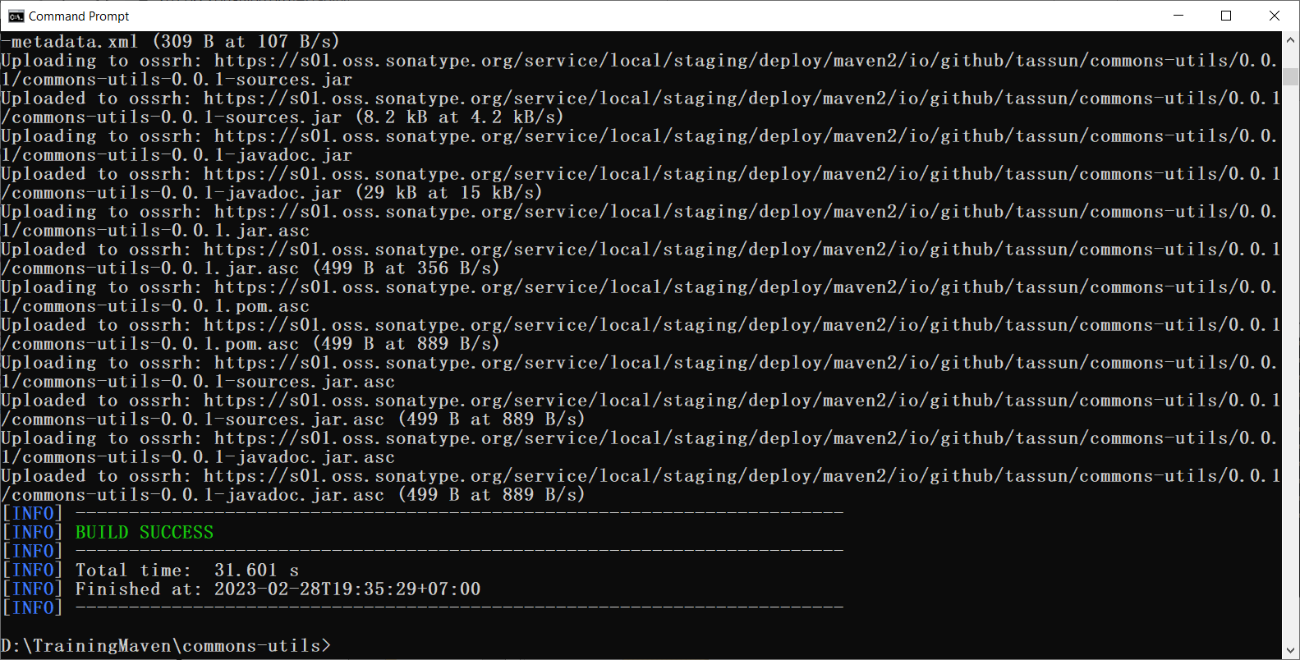
Maven
Maven Central
Deploy

Slide 46
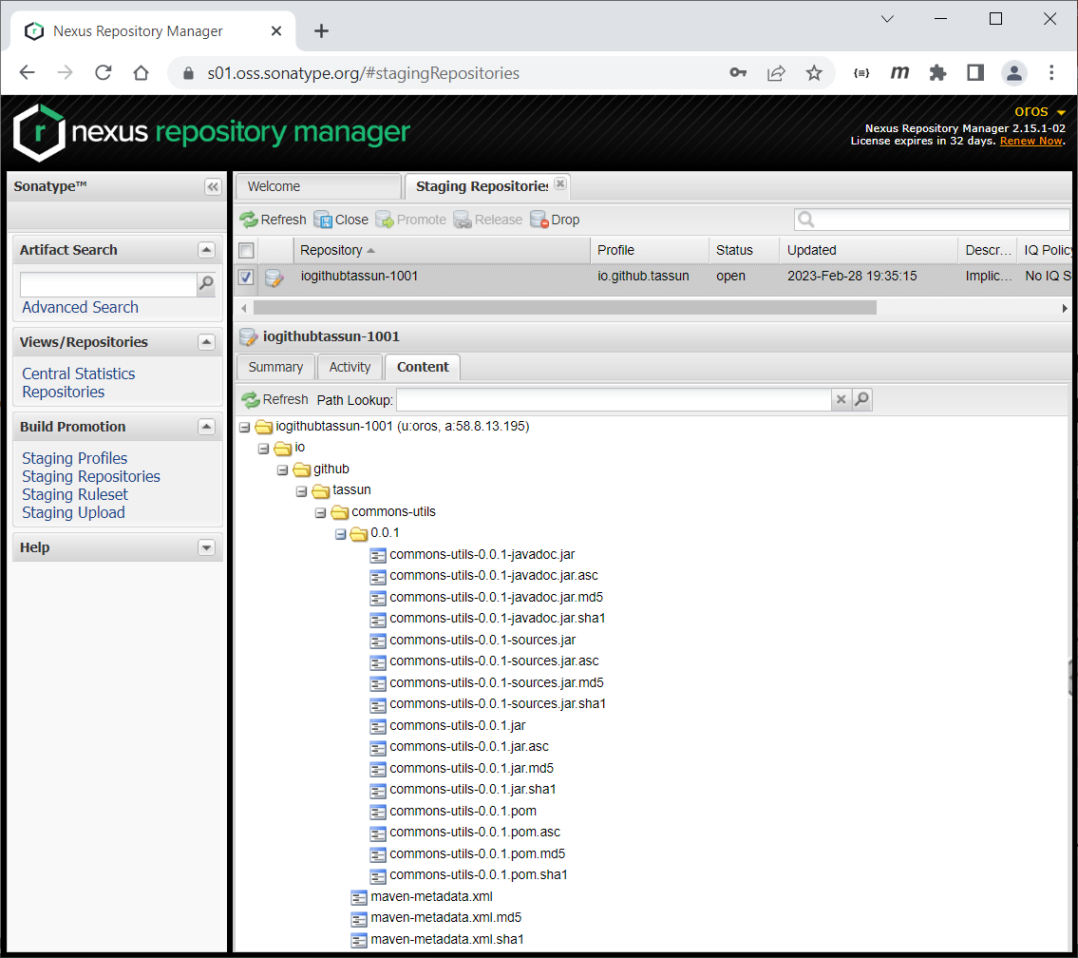
Maven
Maven Central
Release – close -> release
Notes:
Go to Staging Repositories -> Close staging -> Release

Slide 47
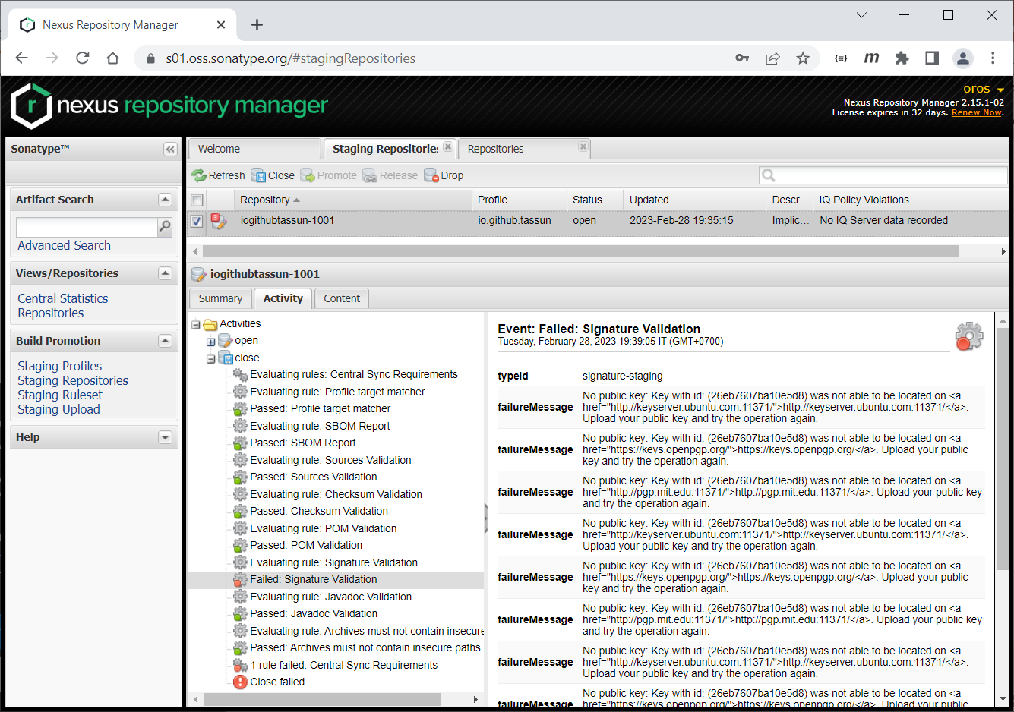
Maven
Maven Central
Release - close -> release
Notes:
Go to Staging Repositories -> Close staging -> Release

Slide 48
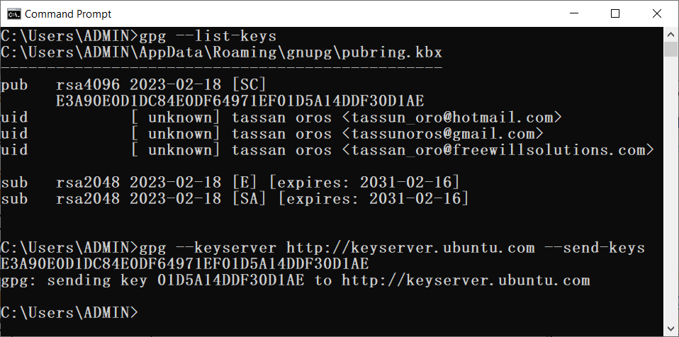
Maven
Maven Central
Release - send key
gpg --keyserver http://keyserver.ubuntu.com --send-keys xxxx

Slide 49
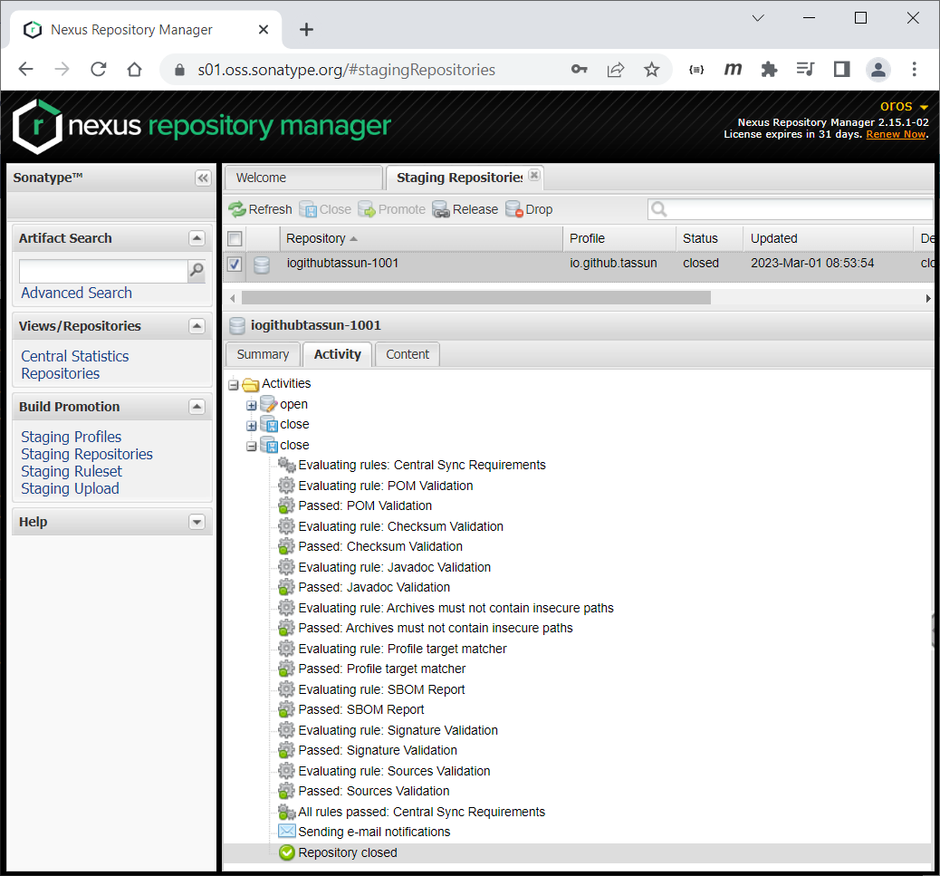
Maven
Maven Central
Release - close -> release
Notes:
Go to Staging Repositories -> Close staging -> Release

Slide 50
Maven
Maven Central
Release
wait for Maven Central to synchronize (take up to 30 minutes)
whereas https://search.maven.org/ can take up to 4 hours to show your newly deployed artifact

Slide 51
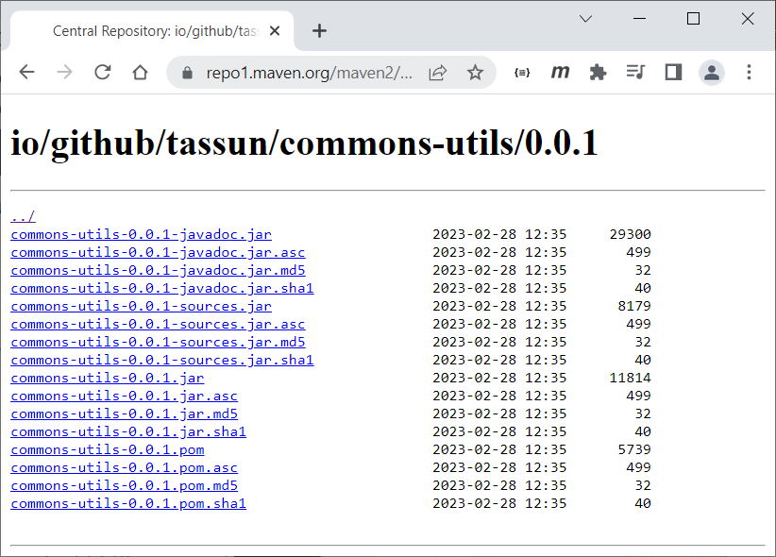
Maven
Maven Central
Release

Slide 52
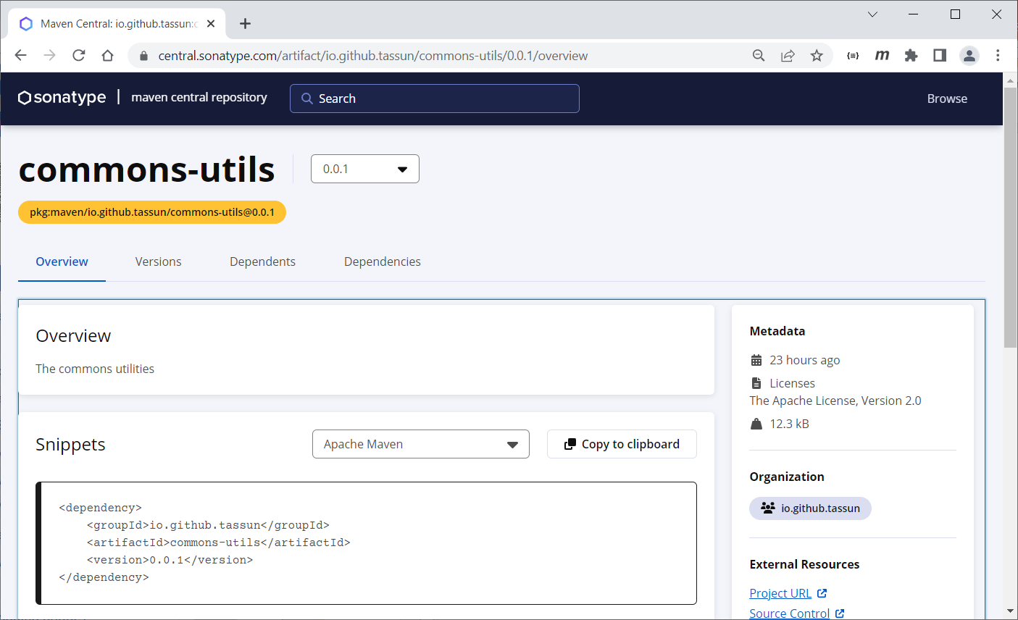
Maven
Maven Central
Release

Slide 53
Reference
https://maven.apache.org
https://www.jittagornp.me/blog/what-is-apache-maven/
https://www.jittagornp.me/blog/basic-maven-command-line/
https://www.baeldung.com/maven-archetype
https://dzone.com/articles/how-to-publish-artifacts-to-maven-central
https://inthecheesefactory.com/blog/how-to-upload-library-to-jcenter-maven-central-as-dependency/th
https://central.sonatype.org/publish/requirements/coordinates/#supported-code-hosting-services-for-personal-groupid
https://central.sonatype.org/publish/publish-guide/
https://central.sonatype.org/publish/publish-maven/

Slide 54
Q & A

